Slide 1

CSCI5308 Advanced Topics in Software Development
Cravate Food Truck Application

Slide 2
Development Team 20 Client Team 26
Het Mehta
Mitul Shah
Pratik Parmar
Edwin Adams
Tanisha

Slide 3

Summary
Cravate is an application being developed to serve as a platform for food trucks in Halifax.
The application allows customers to find and navigate to their preferred food trucks in the city.
Food truck vendors are able to register with the platform to increase visibility and attract more customers.
Admins of the application are able to view records for each user, vendor and food truck and delete the record.

Slide 4

Dashboard Statistics
Total Number of Tasks: 93
Breakdown:
Edwin – 16 tasks | Frontend
Het – 20 tasks | Frontend
Mitul – 20 tasks | Backend
Pratik – 20 tasks | Backend
Tanisha - 17 Tasks | Frontend

Slide 5

Demo
Next we will provide a demonstration of the application!

Slide 6
Project Status
User requirements:
Customer and Vendor access to the app. (Authentication)
Verification of food trucks
Search functionality
Capture of food truck live location and navigation for customers
Leadership Dashboard

Slide 7
Project Status
Goal | Status
Implementation of user requirements/core features | ✔
Integration of frontend and backend code | ✔
Deployment of project via AWS EC2 instance | ✔
Implementation of test cases for back-end code | ✔

Slide 8
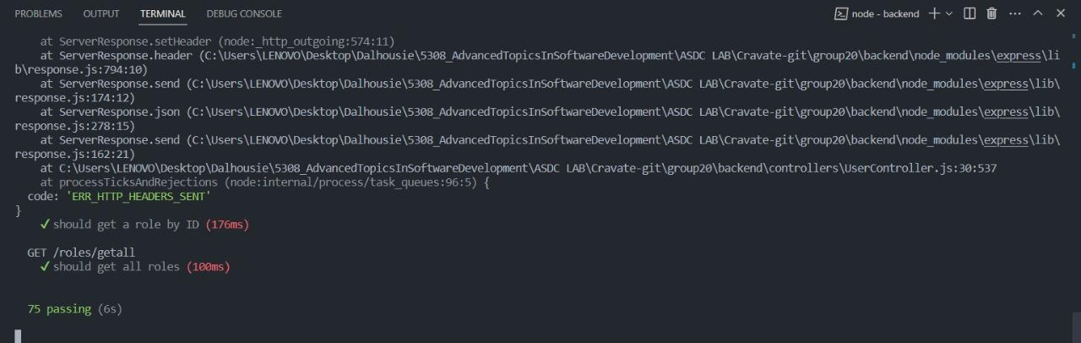
Total number of passed test cases

Slide 9
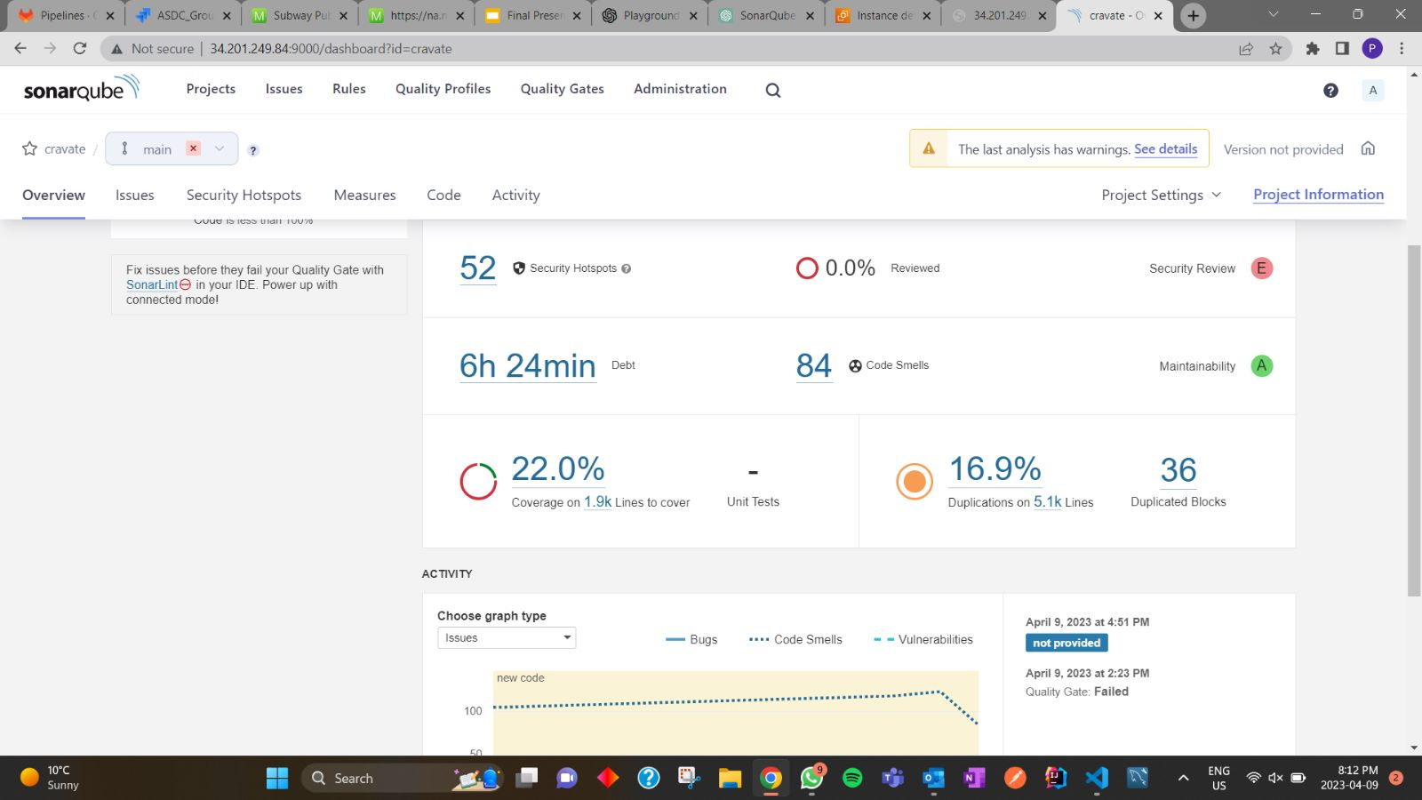
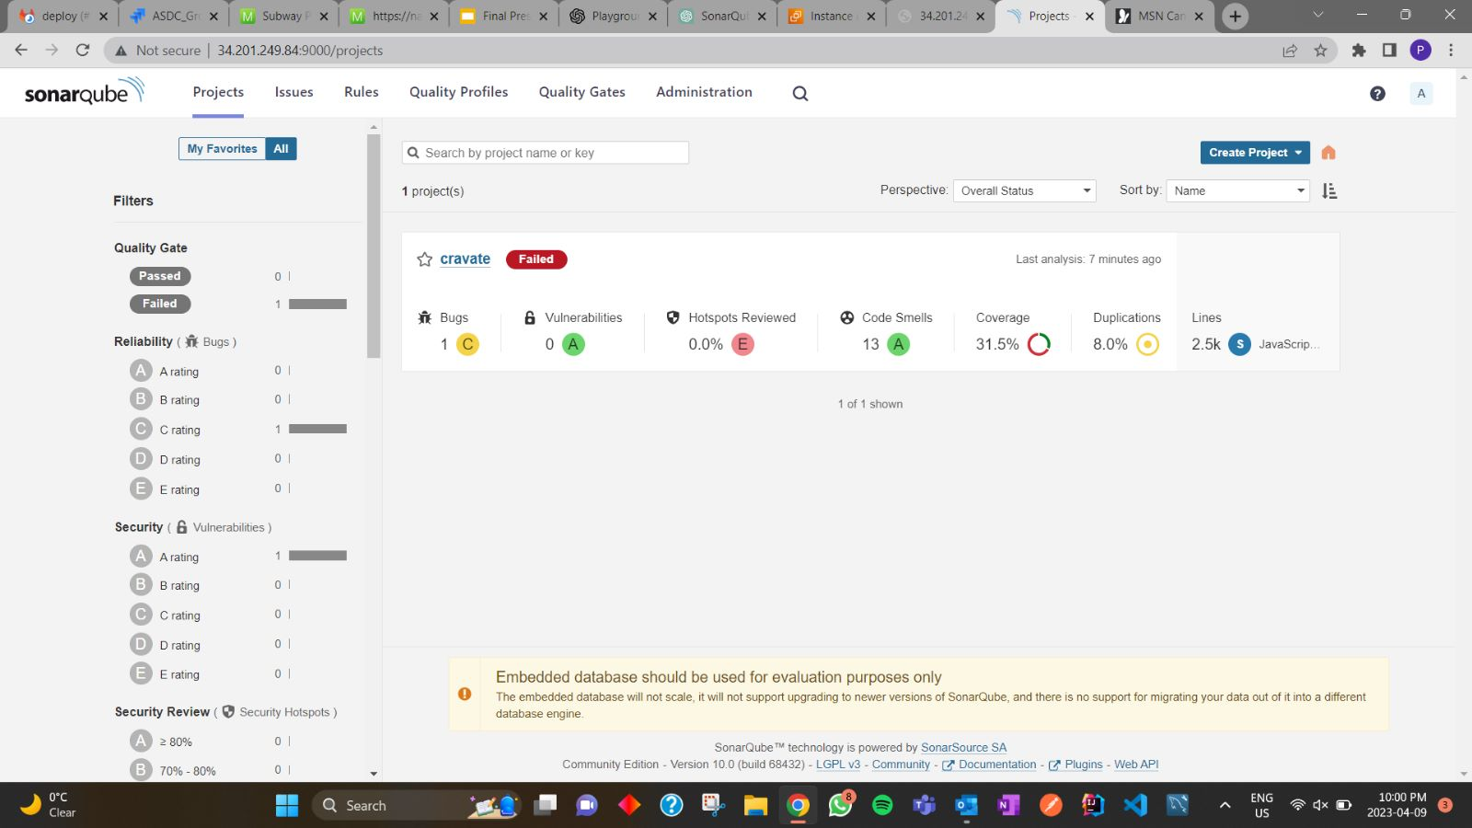
Code smells & Code coverage
Before refactoring
84 code smells and 22% overall code coverage(frontend & backend)
After refactoring
13 code smells and 31.5% overall code coverage(frontend & backend)

Slide 10
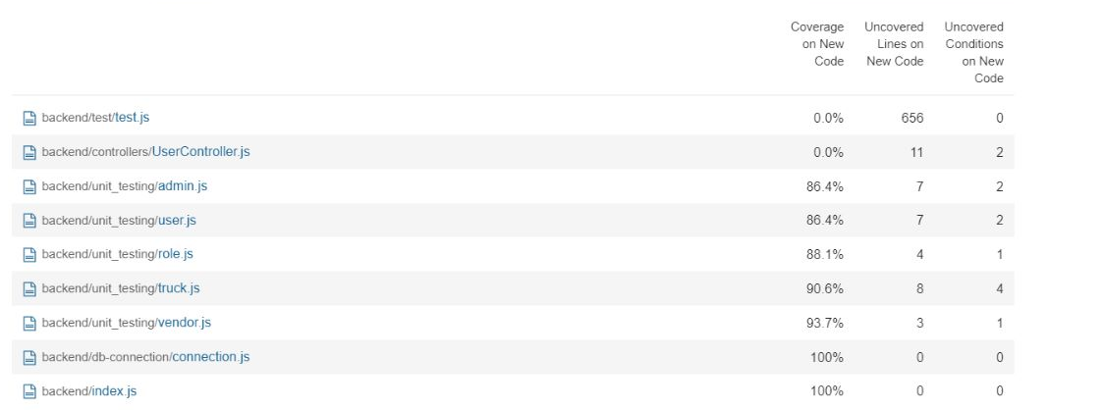
Backend Code Coverage

Slide 11



Learning From the Project
COMMUNICATION WITHIN A DEVELOPMENT TEAM.
REACT NATIVE DEVELOPMENT
INTEGRATION OF FRONTEND AND BACKEND

